Slide 1
https://eclass.prog.aspete.gr/modules/document/file.php/PESYP_THESSAL11101/%CE%9F%CE%99%CE%9A%CE%9F%CE%93%CE%95%CE%9D%CE%95%CE%99%CE%91%CE%9A%CE%97%20%CE%A3%CE%A5%CE%9C%CE%92%CE%9F%CE%A5%CE%9B%CE%95%CE%A5%CE%A4%CE%99%CE%9A%CE%97.pdf

Slide 2
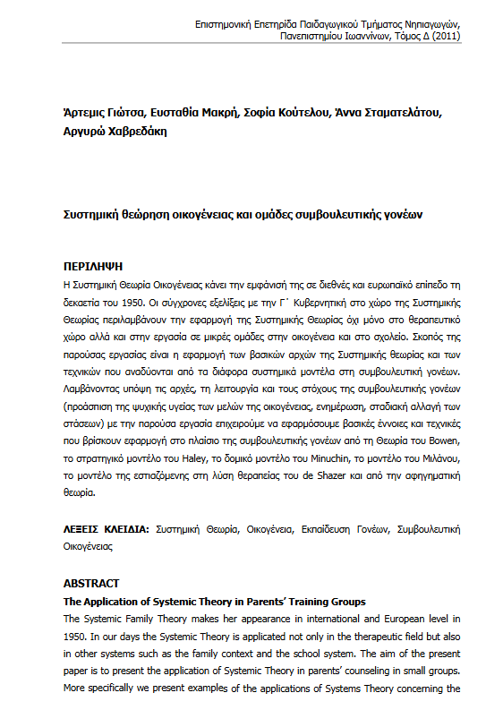
https://ejournals.epublishing.ekt.gr/index.php/jret/article/view/8684/8955

Slide 3
https://repository.kallipos.gr/handle/11419/9350

Slide 4
https://repository.kallipos.gr/bitstream/11419/9815/17/473-ATHANASIADOU-%20Feminist-Psychology.pdf

Slide 5
https://ejournals.epublishing.ekt.gr/index.php/socwork/issue/view/2029/917

Slide 6
https://repository-edulll.ekt.gr/edulll/retrieve/5016/1435_03_MGasouka_DiastasiFilouSxoleio_oikogeneia.pdf

Slide 7
https://ejournals.epublishing.ekt.gr/index.php/omep/article/view/17934/15948

